Slide 1
Towards patient-specific modeling of Atherosclerotic Arterial Sections
Stephan Gahima^{1,2}
Pedro Dìez^{1,2}, Marco Stefanati³, José Félix Rodríguez Matas³, Alberto García-González^{1,2}
¹ Laboratori de Càlcul Numèric E.T.S. de Ingeniería de Caminos, Universitat Politècnica de Catalunya Campus Norte UPC, 08034 Barcelona, Spain ² International Center for Numerical Methods in Engineering (CIMNE) ³ Laboratory of Biological Structure Mechanics (LaBS), Department of Chemistry, Materials and Chemical Engineering “Giulio Natta”, Politecnico di Milano, Milan, Italy
Zhongzhao Teng
from the University of Cambridge

Slide 2
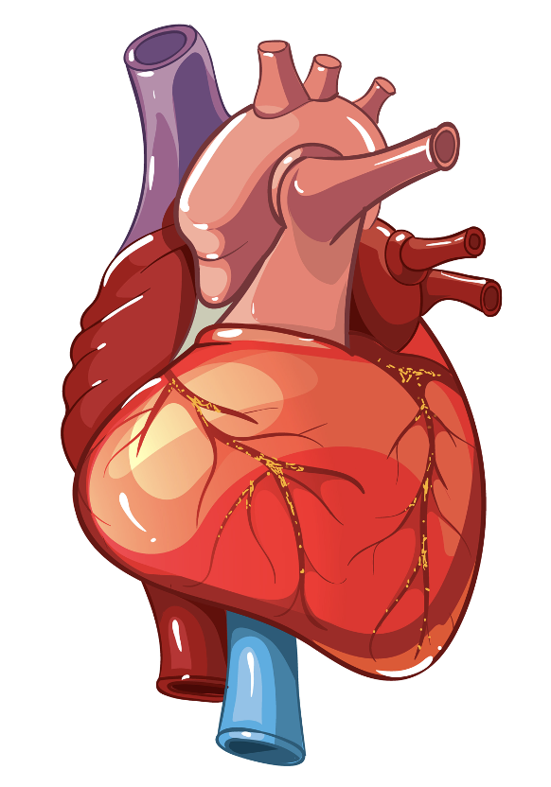
Overview
Background
Motivation
Methods
Contributions
Heart image is
Designed by macrovector / Freepik.

Slide 3
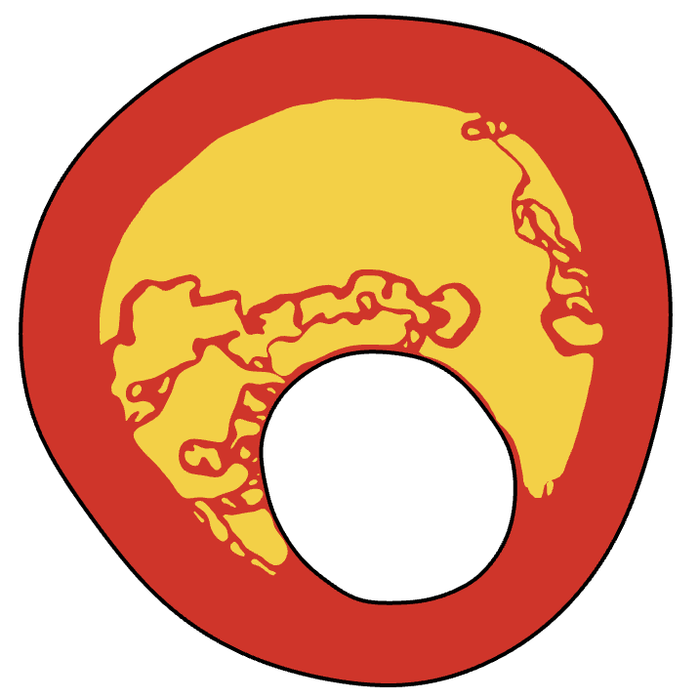
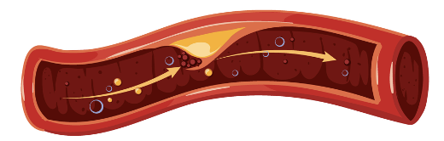
What is atherosclerosis?
Atherosclerotic Plaque build-up

Slide 4
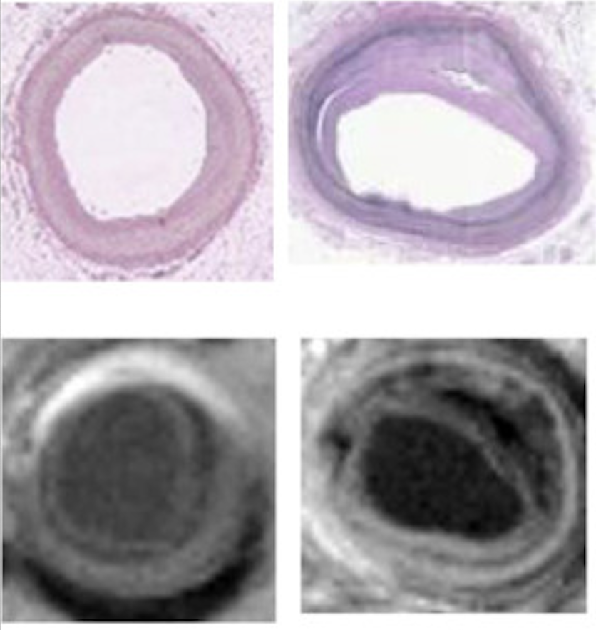
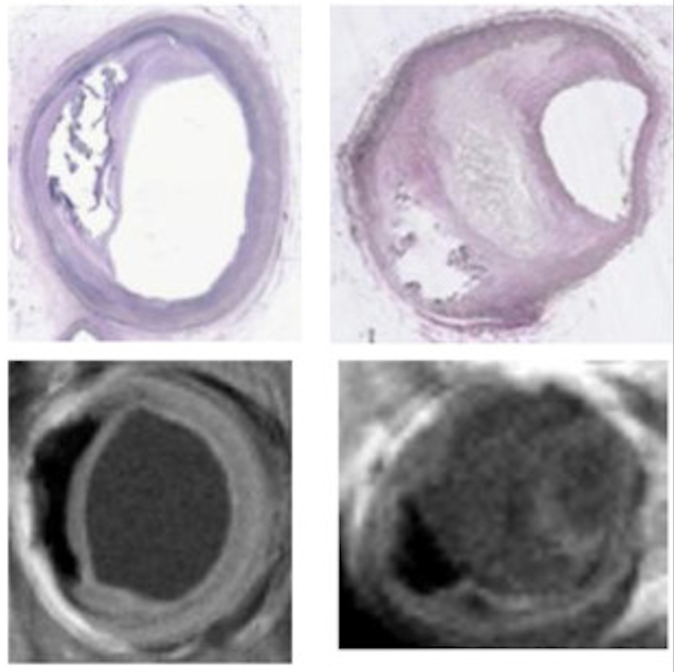
Example: Stable VS Unstable plaque
(Fan et al., 2014)
Stable (low risk of rupture)
Unstable (high risk of rupture)

Slide 5
Cardiovascular diseases are expected to increase in the future.
Atherosclerosis is the most common cause of a heart attack.
Background
Motivation
Methods
Contributions
Can we provide a tool to support clinicians' decision-making process for atherosclerosis?
Segmentation of Medical Images
Modelling
Patient-specific high fidelity Finite Element (FE) solver
Reduced Order Model (ROM)
Gahima, S., Díez, P., Stefanati, M., Rodríguez Matas, J. F., & García-González, A. (2023).
An Unfitted Method with Elastic Bed Boundary Conditions for the Analysis of Heterogeneous Arterial Sections.
Mathematics, 11(7), 1748. https://doi.org/10.3390/math11071748

Slide 6
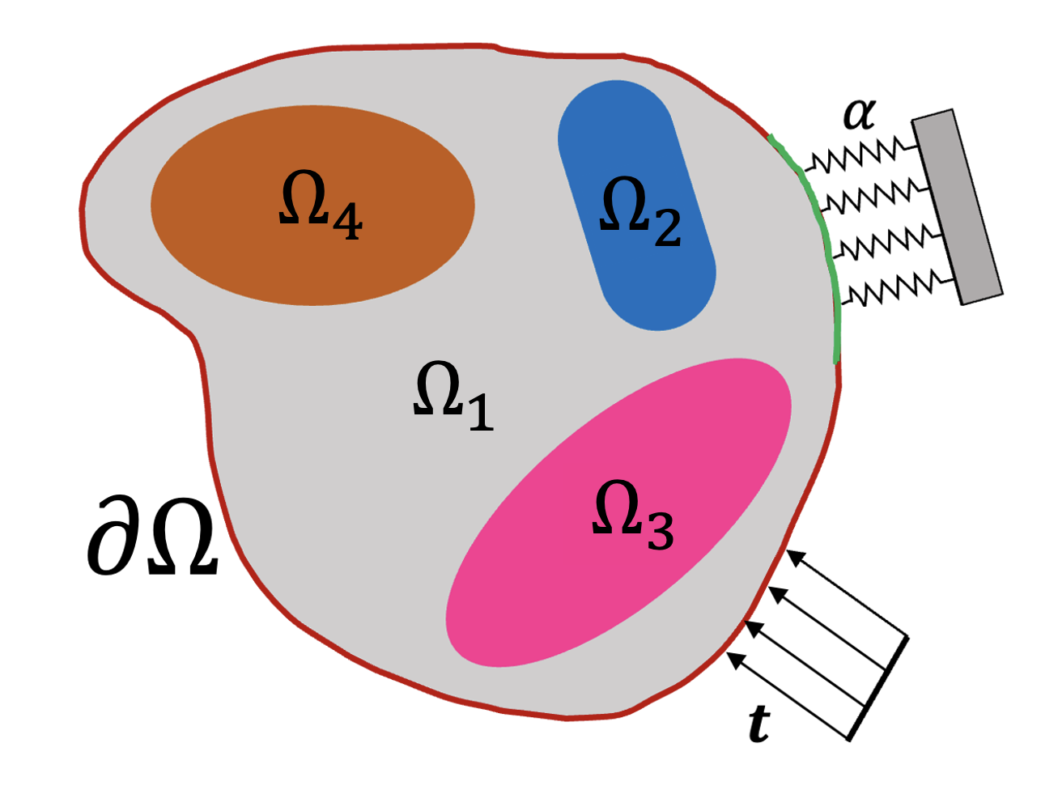
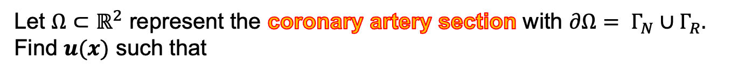
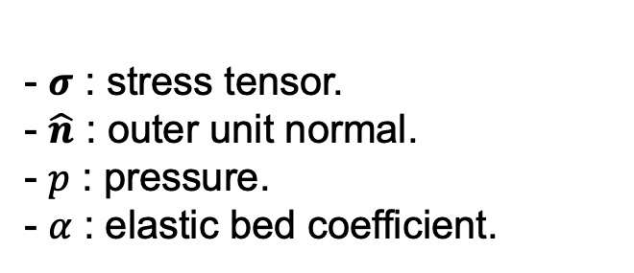
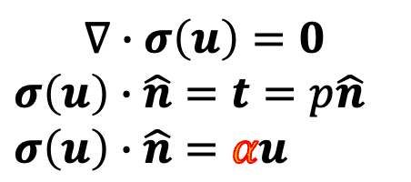
Problem Statement – 2D linear elasticity
Let $Ω⊂ℝ^{2}$ represent the coronary artery section with $∂Ω= Γ_{N}∪Γ_{R}.$
Find $u(x)$ such that
Background
Motivation
Methods
Contributions
$$∇∙σ\left(u\right)=0$$
$$σ\left(u\right)∙\hat{n}=t=p\hat{n}$$
$$σ\left(u\right)∙\hat{n}=αu$$
- 𝝈 : stress tensor.
- $\hat{n}$ : outer unit normal.
- 𝑝 : pressure.
- 𝛼 : elastic bed coefficient.
Assumptions:
Piecewise homogeneous
Quasi-static
Robin condition

Slide 7
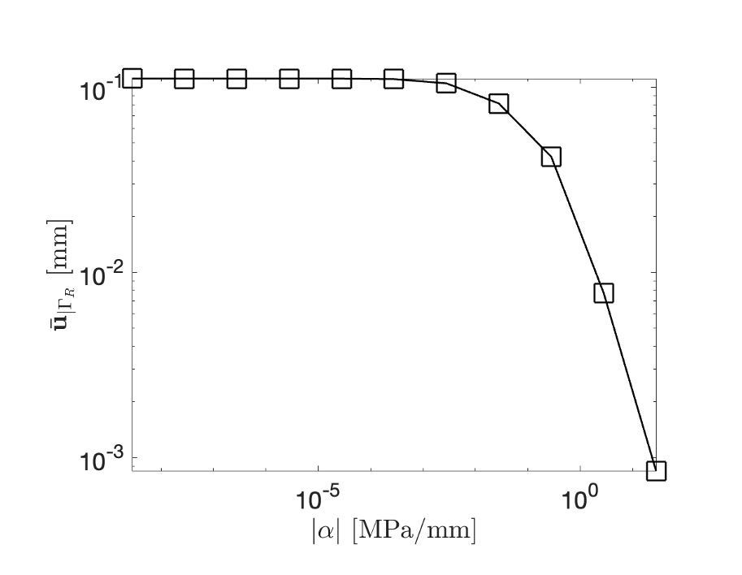
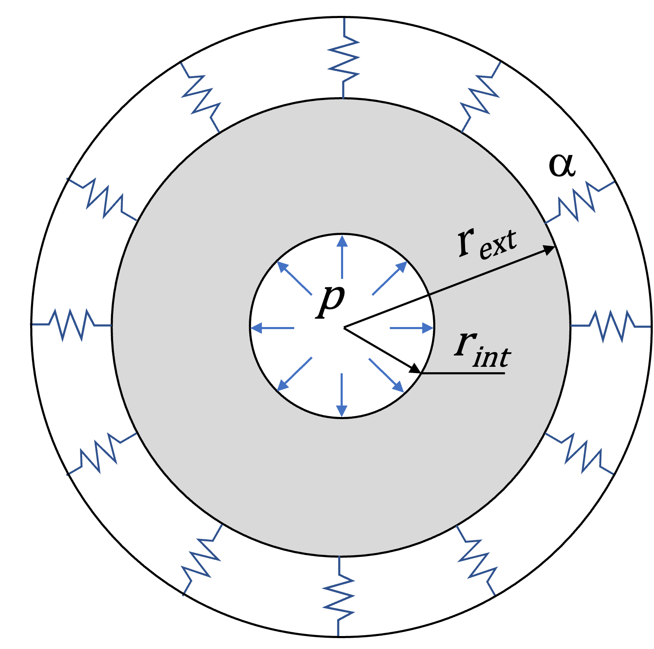
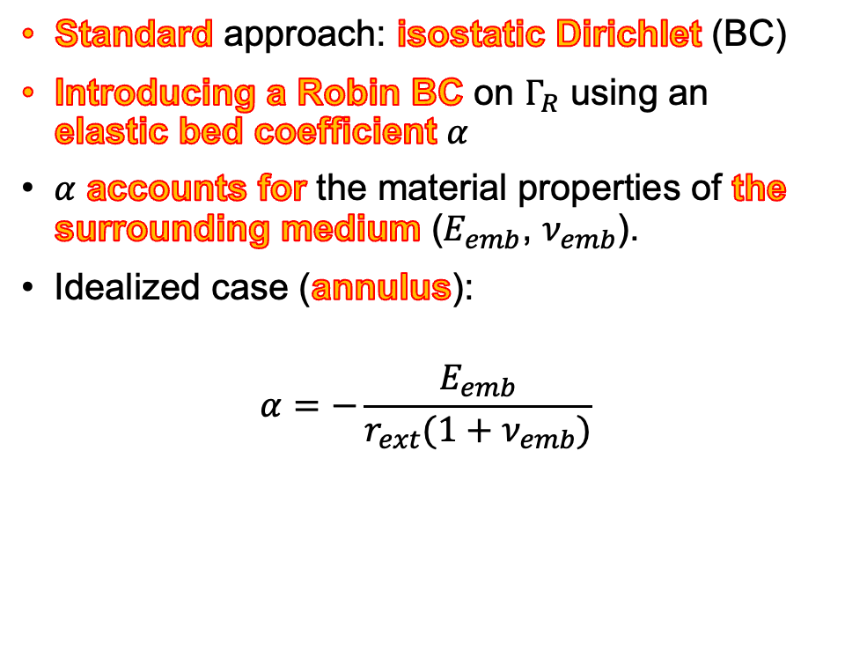
Modeling - Robin boundary condition
Standard approach: isostatic Dirichlet (BC)
Introducing a Robin BC on $Γ_{R}$ using an elastic bed coefficient 𝛼
𝛼 accounts for the material properties of the surrounding medium ($E_{emb}$, $ν_{emb}$).
Idealized case (annulus):
$$α=−\frac{E_{emb}}{r_{ext}(1+ν_{emb})}$$
Physically meaningful and flexible boundary condition.

Slide 8
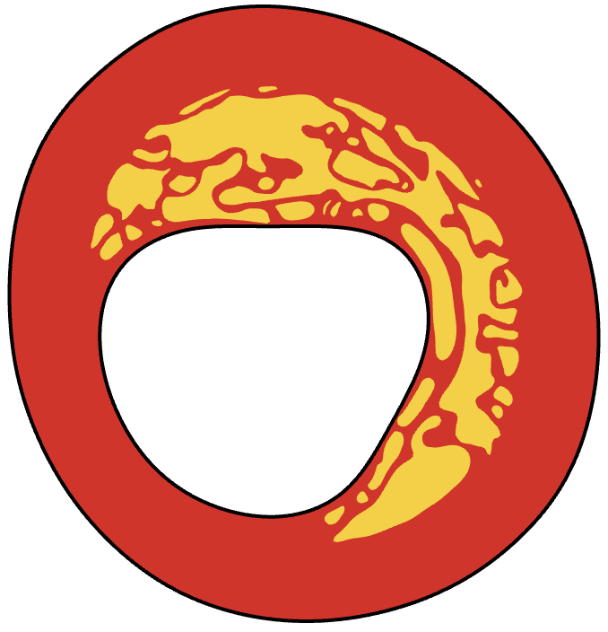

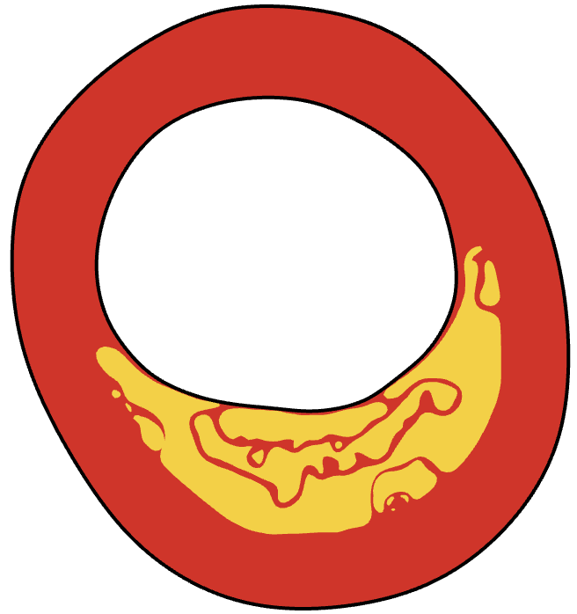
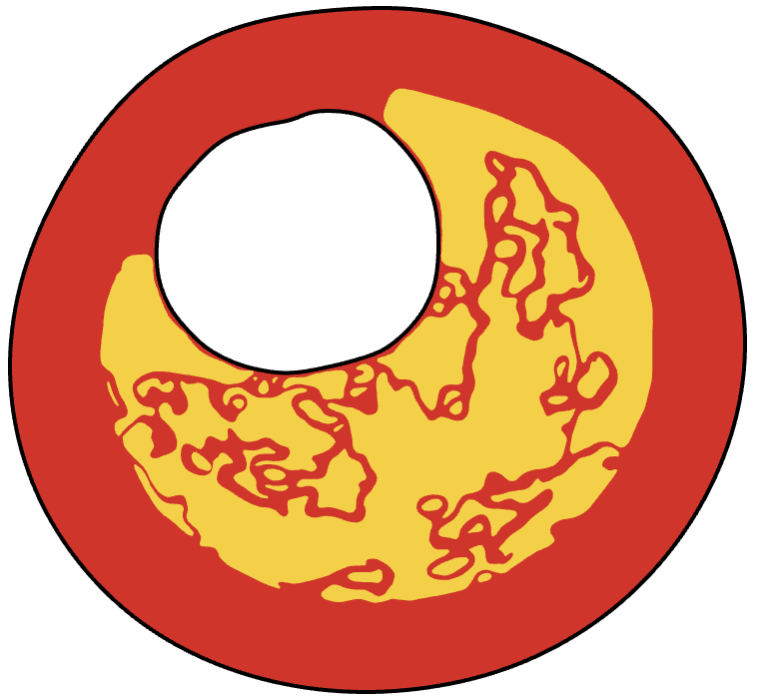
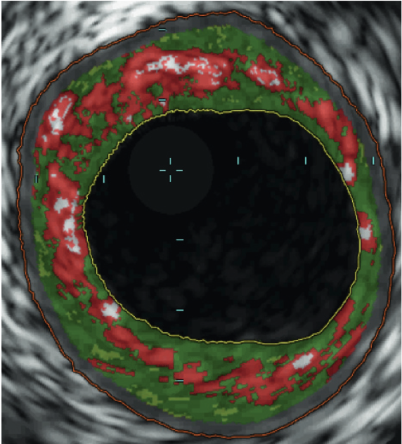
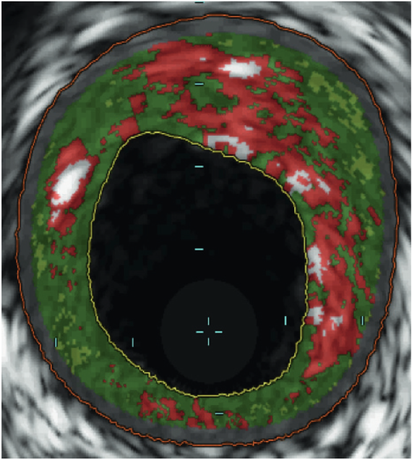
Patient-specific – high fidelity FE solver
Geometries are segmented from medical images.
Many geometrical configurations.
An unfitted approach is capable of handling different geometries and can be easily integrated with image segmentation.
We require a method to describe the geometry.
Geometrical configurations
Medical images
(Costopoulos et al., 2017)

Slide 9
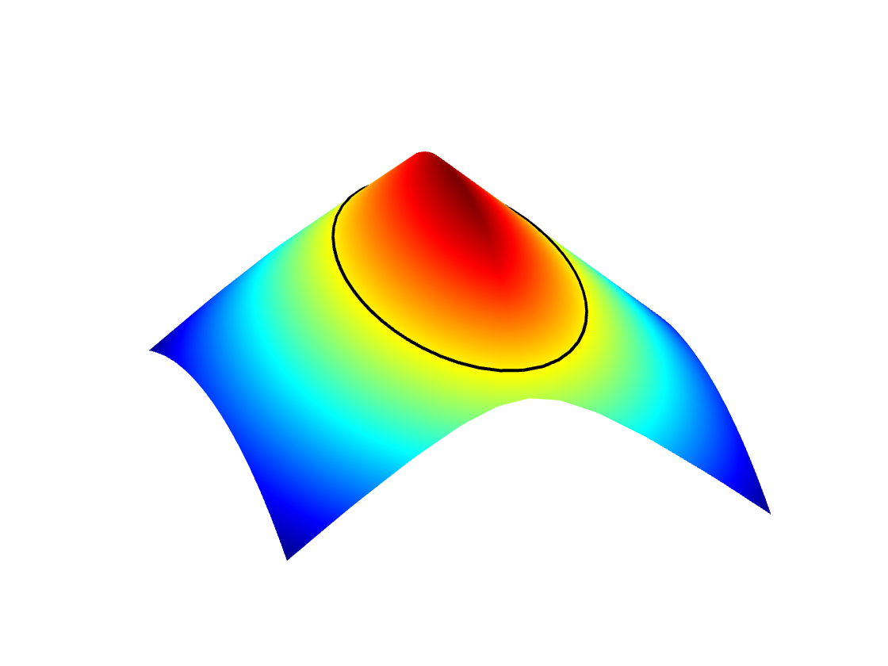
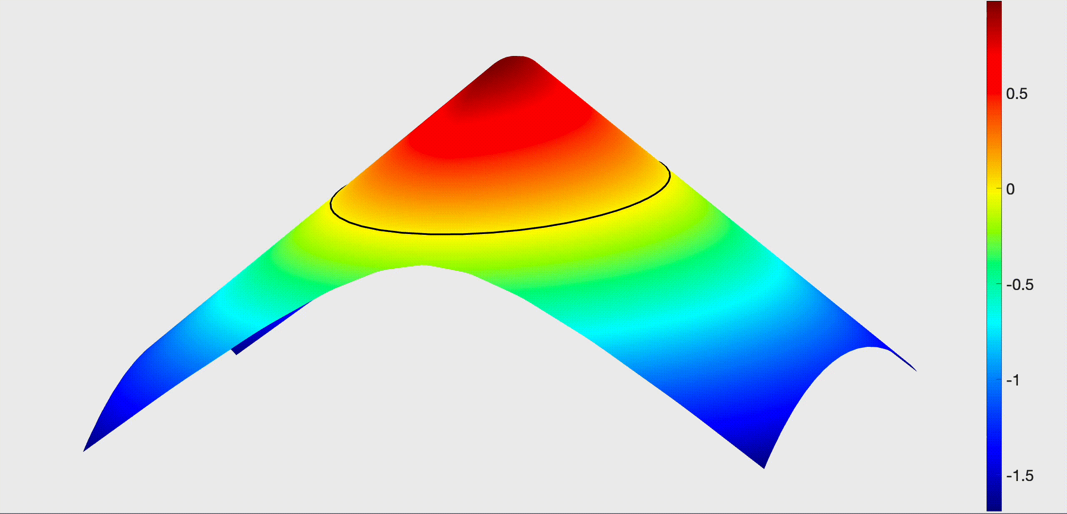
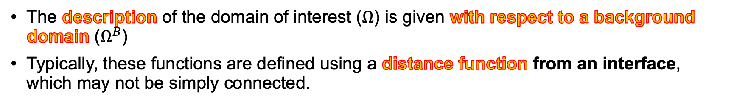
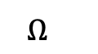
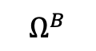
Level Set - description of the geometry
The description of the domain of interest ($Ω$) is given with respect to a background domain ($Ω^{B}$)
Typically, these functions are defined using a distance function from an interface, which may not be simply connected.
$$Ω^{}$$
$$Ω^{B}$$

Slide 10
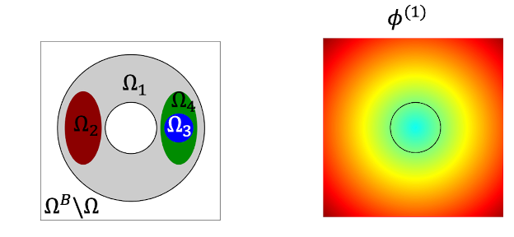
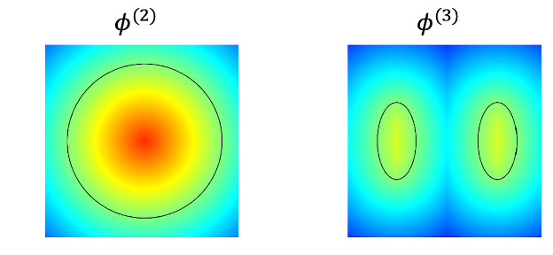
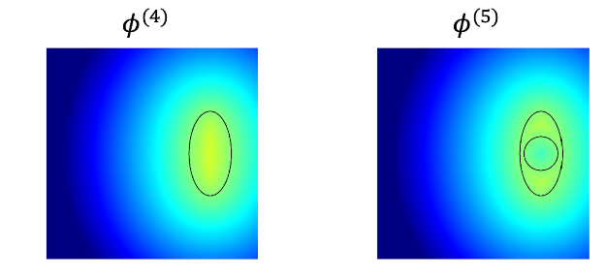
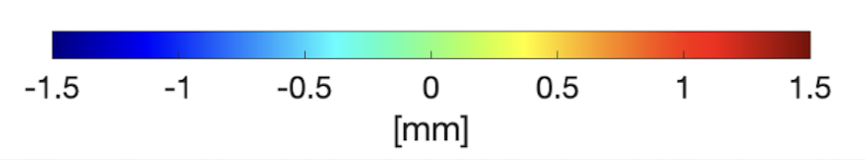
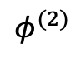
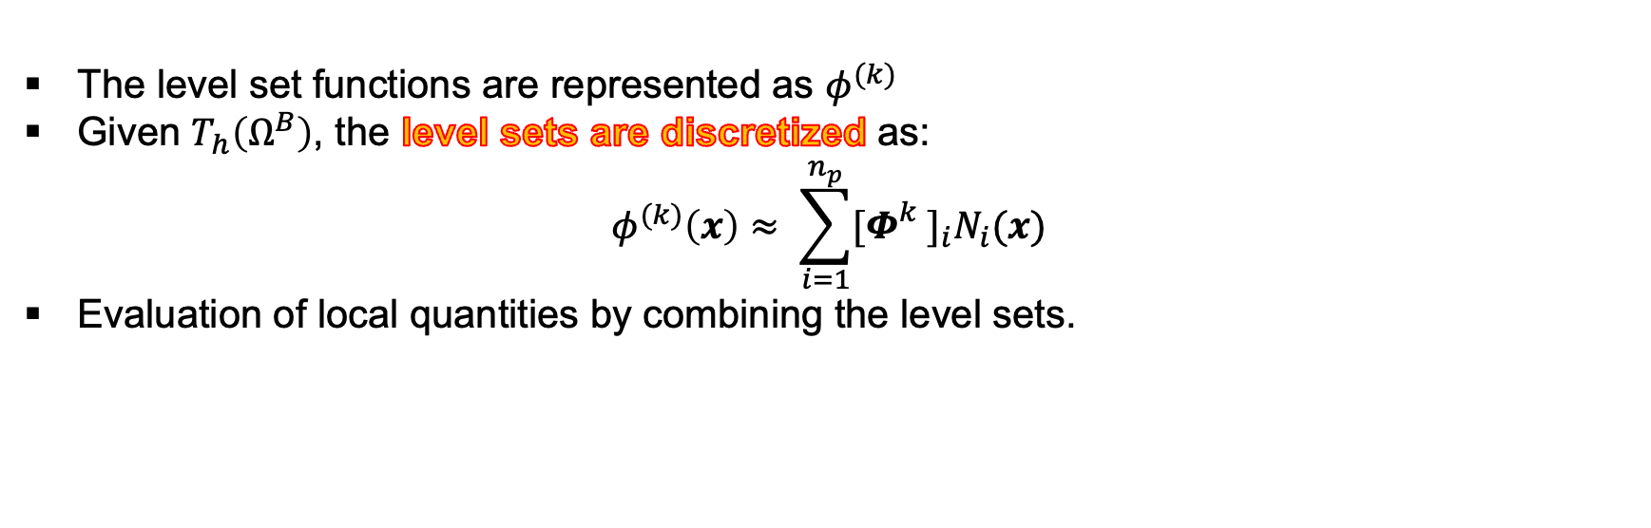
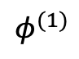
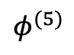
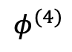
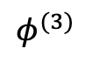
Hierarchical Level Sets – to deal with multiple materials
The level set functions are represented as $φ^{(k)}$
Given $T_{h}\left(Ω^{B}\right)$, the level sets are discretized as:
$$φ^{(k)}\left(x\right)≈ \sum_{i=1}^{n_{p}}{{[Φ_{}^{k}]}_{i}N_{i}(x)}$$
Evaluation of local quantities by combining the level sets.
$$φ^{(1)}$$
$$φ^{(2)}$$
$$φ^{(3)}$$
$$φ^{(4)}$$
$$φ^{(5)}$$

Slide 11
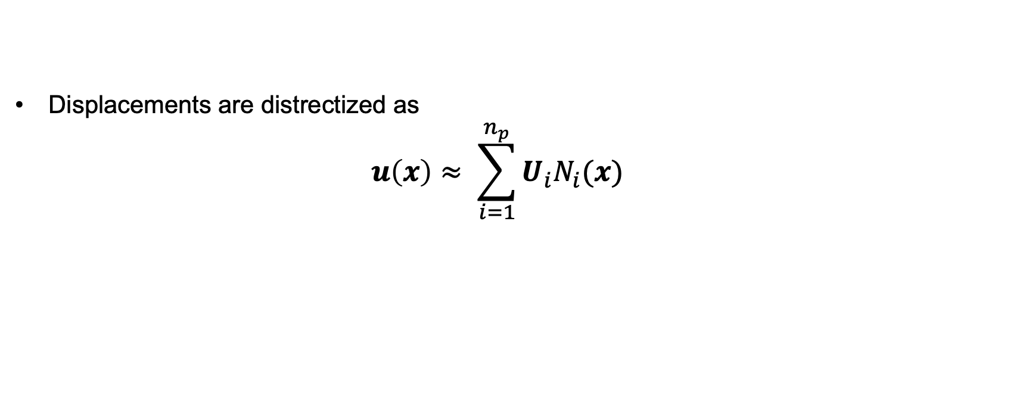
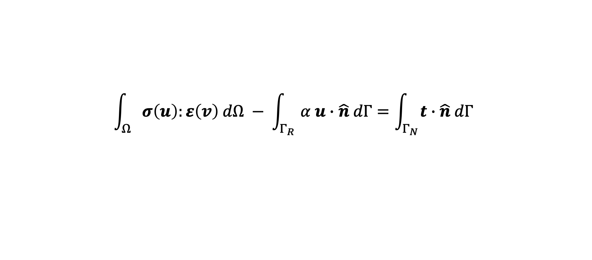
Classical FE
$$\int_{Ω}{σ\left(u\right):ε\left(v\right) dΩ − \int_{Γ_{R}}{α u∙\hat{n} dΓ=\int_{Γ_{N}}{t∙\hat{n} dΓ }}}$$
Displacements are distrectized as
$$u\left(x\right)≈ \sum_{i=1}^{n_{p}}{U_{i}N_{i}(x)}$$
$$\left(K+M\right)U=F$$

Slide 12
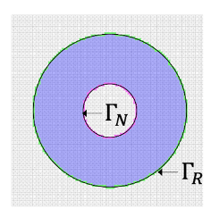
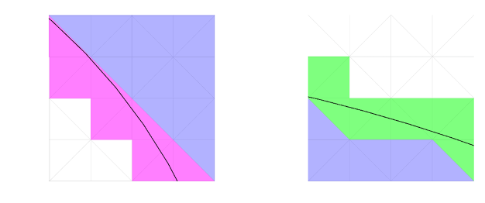
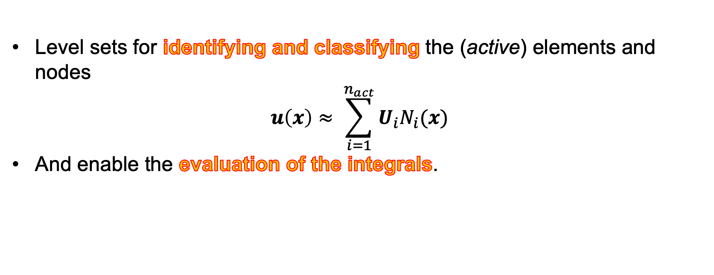
From Classical to Unfitted FE
Level sets for identifying and classifying the (active) elements and nodes
$$u\left(x\right)≈ \sum_{i=1}^{n_{act}}{U_{i}N_{i}(x)}$$
And enable the evaluation of the integrals.

Slide 13
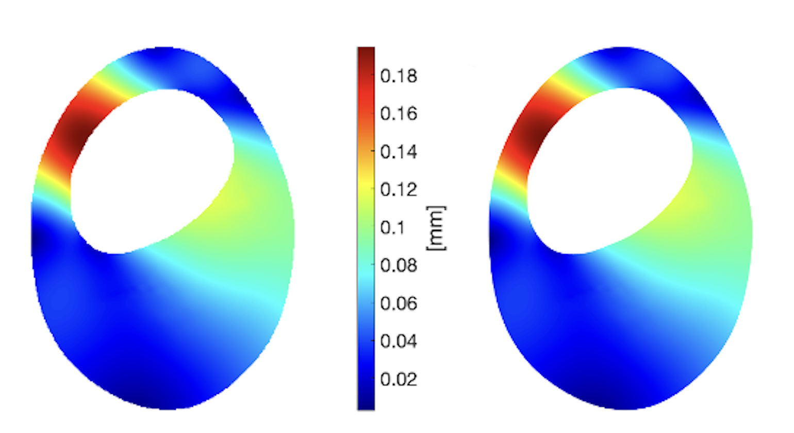
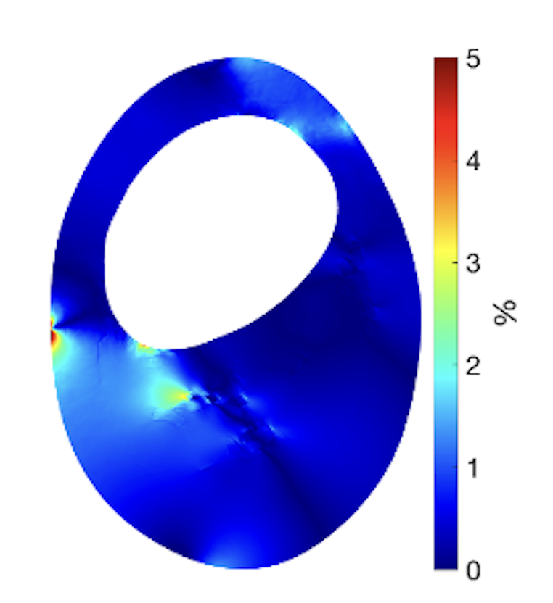
Numerical Results – Unfitted VS Classical FE
Unfitted
Classical
Relative error
Displacements magnitude

Slide 14
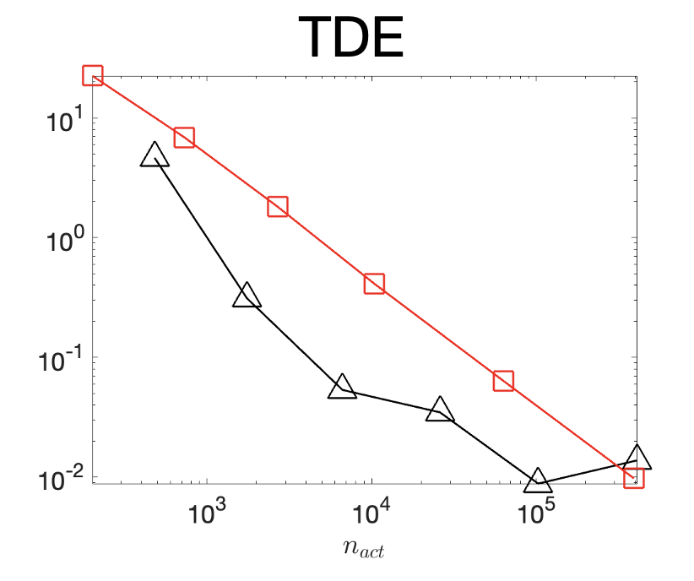
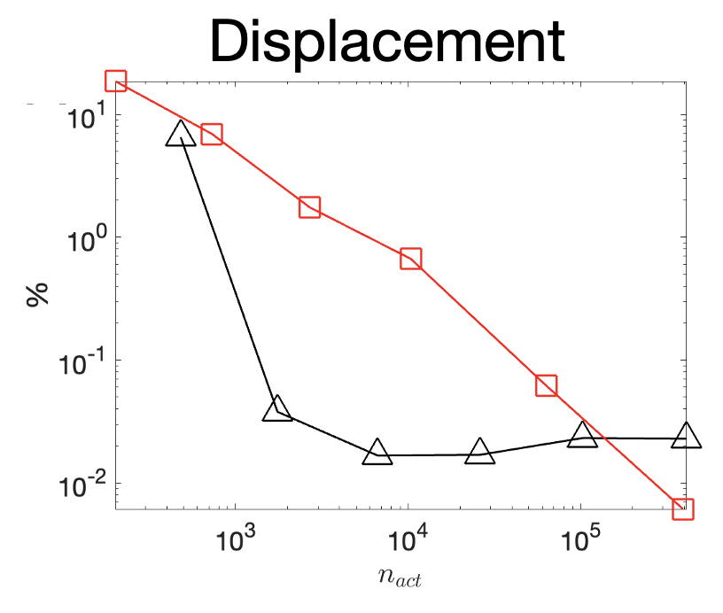
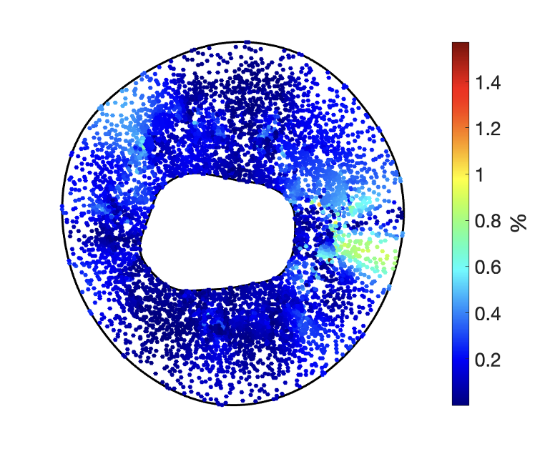
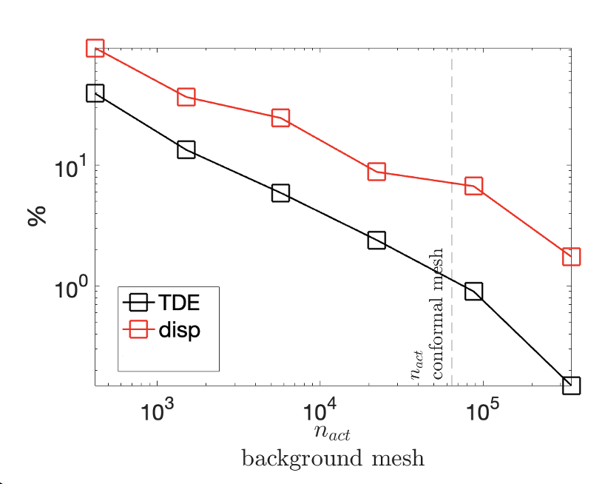
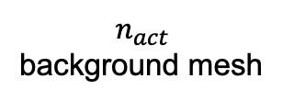
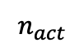
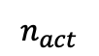
Numerical Results – Convergence analysis
$$n_{act}$$
$$n_{act}$$
$$n_{act}$$
background mesh
Relative error for Total Deformation Energy (TDE) can be < 0.05 %
Average relative error for dispacements can be < 0.5 %

Slide 15

Novel modelling approach accounting for the surroundings.
Incorporate hierarchical level sets within an unfitted framework for patient-specific computations.
Background
Motivation
Methods
Contributions
Flexibility to change $α$ as desired.
No need for remeshing.
FE solution from segmented medical images.
Paves the way for ROM.

Slide 16

Thanks for your attention!

